Slide 1

Algebra 1
Unit 7, Lesson 7 Factoring Perfect Square Trinomials Volume 1, pg. 391

Slide 2


Benchmark
MA.912.AR.1.7
Rewrite a polynomial expression as a product of polynomials over the real number system.
volume 1, pg. 391

Slide 3
Integrated Mathematical Thinking and Reasoning Standards
MA.K12.MTR.2.1 Demonstrate understanding by representing problems in multiple ways.
MA.K12.MTR.3.1 Complete tasks with mathematical fluency.
MA.K12.MTR.4.1 Engage in discussions that reflect on the mathematical thinking of self and others.
MA.K12.MTR.5.1 Use patterns and structure to help understand and connect mathematical concepts.
volume 1, pg. 391

Slide 4

Learning Target
I can factor perfect square trinomials.
volume 1, pg. 391

Slide 5

Warm-Up
volume 1, pg. 391

Slide 6
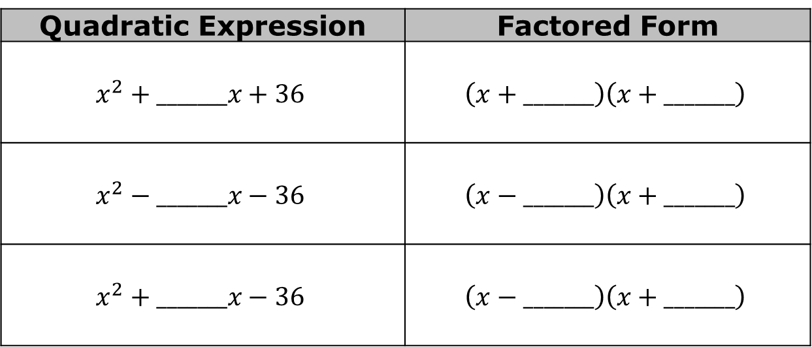
7.7.1 Warm-Up: Critical Thinking
Fill in the blanks with an integer so that the quadratic expression is factorable. Then, complete the factored form.
Quadratic Expression | Factored Form
$$x^{2}+_______x+36$$ | $$\left(x+_______\right)\left(x+_______\right)$$
$$x^{2}−_______x−36$$ | $$\left(x−_______\right)\left(x+_______\right)$$
$$x^{2}+_______x−36$$ | $$\left(x−_______\right)\left(x+_______\right)$$
volume 1, pg. 391

Slide 7

Collaboration
volume 1, pg. 392

Slide 8

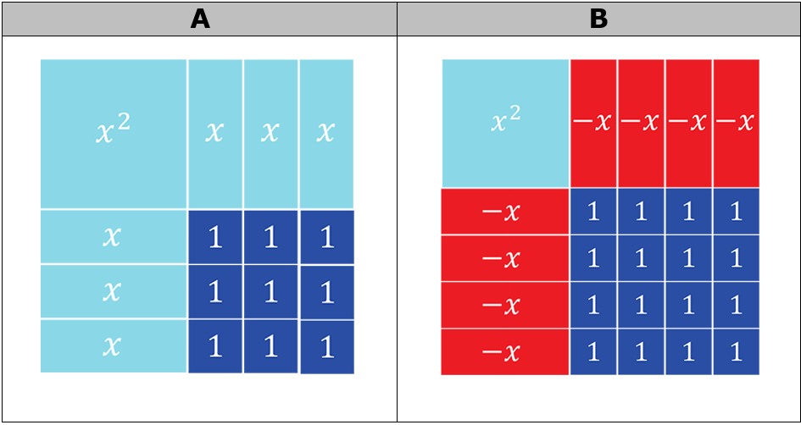
7.7.2 Collaboration: Perfect Square Trinomials
The quadratic expressions represented by algebra tiles are perfect square trinomials.
volume 1, pg. 392

Slide 9
Discuss with your partner why these quadratic expressions are called perfect square trinomials.
Write the trinomials represented by the algebra tiles.
Use the algebra tile representations to write the factored form of each trinomial.
Trinomial A | Trinomial B
Factored Form of Trinomial A | Factored Form of Trinomial B
volume 1, pg. 392

Slide 10
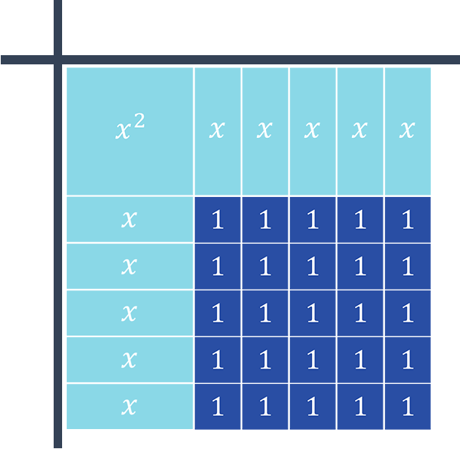
The quadratic expression $x^{2}+10x+25$ is represented by the algebra tiles.
volume 1, pg. 393

Slide 11
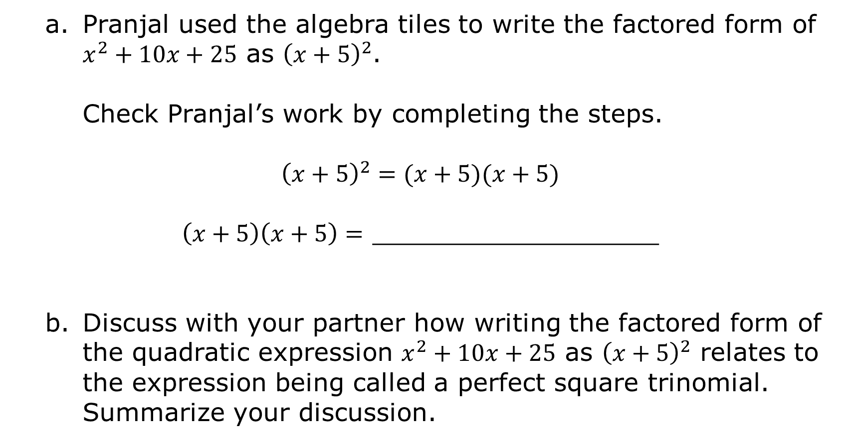
Pranjal used the algebra tiles to write the factored form of $x^{2}+10x+25$ as ${\left(x+5\right)}^{2}$.
Check Pranjal’s work by completing the steps.
$${\left(x+5\right)}^{2}=(x+5)(x+5)$$
$\left(x+5\right)\left(x+5\right)=$ __________________
Discuss with your partner how writing the factored form of the quadratic expression $x^{2}+10x+25$ as ${\left(x+5\right)}^{2}$ relates to the expression being called a perfect square trinomial. Summarize your discussion.
volume 1, pg. 393

Slide 12
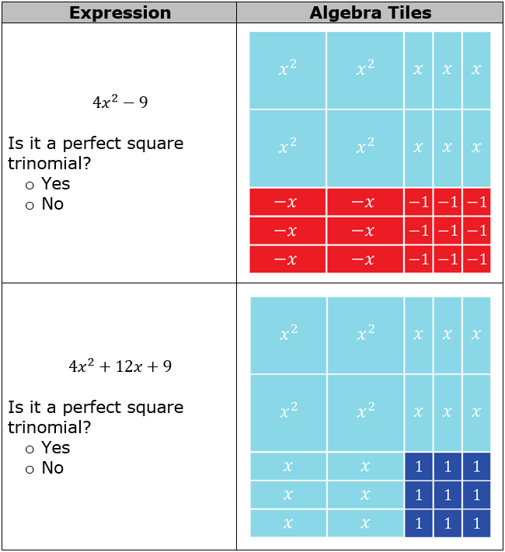
Work with your partner to determine which quadratic expressions are perfect square trinomials.
volume 1, pg. 393

Slide 13
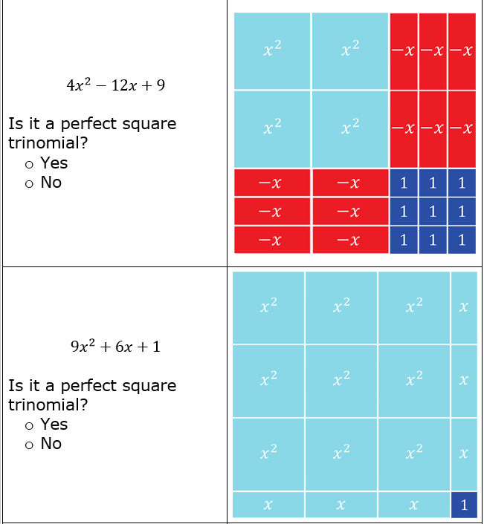
volume 1, pg. 394

Slide 14
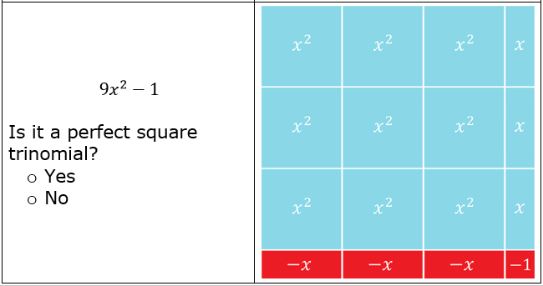
Describe some key characteristics of perfect square trinomials by relating both the representation of a quadratic expression using algebra tiles and the trinomial.
volume 1, pg. 394

Slide 15

Guided Instruction
volume 1, pg. 395

Slide 16
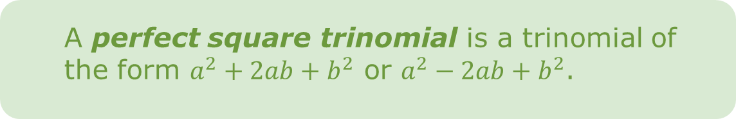
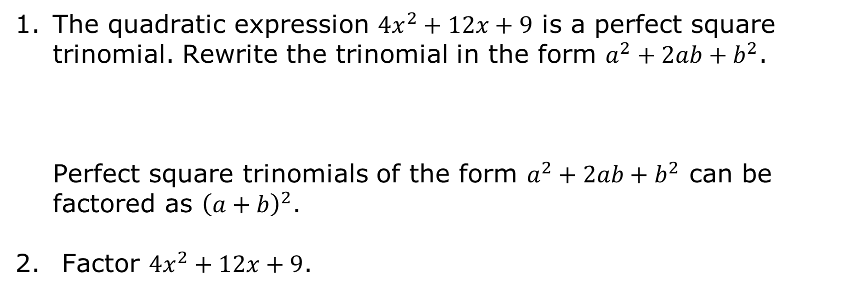
7.7.3 Guided Instruction: Factoring Perfect Square Trinomials
A perfect square trinomial is a trinomial of the form $a^{2}+2ab+b^{2}$ or $a^{2}−2ab+b^{2}$.
The quadratic expression $4x^{2}+12x+9$ is a perfect square trinomial. Rewrite the trinomial in the form $a^{2}+2ab+b^{2}$.
Perfect square trinomials of the form $a^{2}+2ab+b^{2}$ can be factored as ${\left(a+b\right)}^{2}$.
Factor $4x^{2}+12x+9$.
volume 1, pg. 395

Slide 17
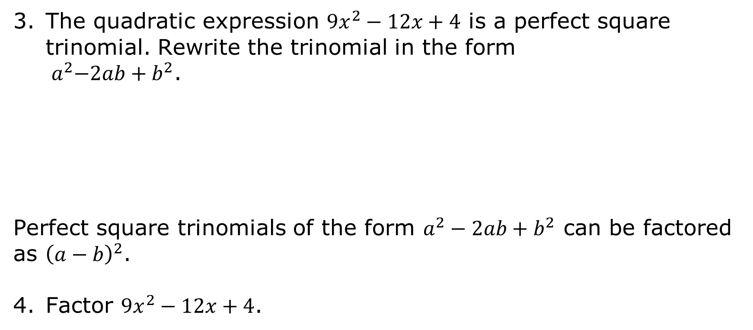
The quadratic expression $9x^{2}−12x+4$ is a perfect square trinomial. Rewrite the trinomial in the form
${ a}^{2}−2ab+b^{2}$.
Perfect square trinomials of the form $a^{2}−2ab+b^{2}$ can be factored as ${\left(a−b\right)}^{2}$.
Factor $9x^{2}−12x+4$.
volume 1, pg. 395

Slide 18

Guided Practice
volume 1, pg. 396

Slide 19

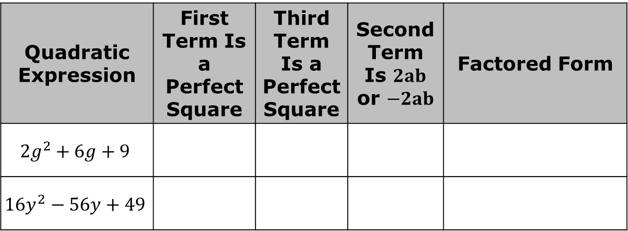
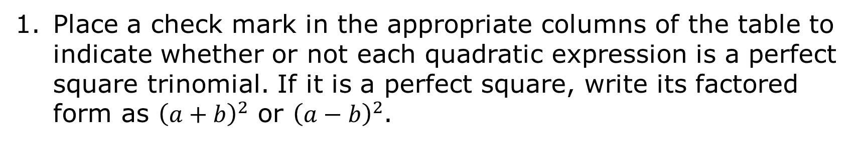
7.7.4 Guided Practice: Factoring Perfect Square Trinomials
Place a check mark in the appropriate columns of the table to indicate whether or not each quadratic expression is a perfect square trinomial. If it is a perfect square, write its factored form as ${\left(a+b\right)}^{2}$ or ${\left(a−b\right)}^{2}$.
Quadratic Expression | First Term Is a Perfect Square | Third Term Is a Perfect Square | Second Term Is $2ab$ or $−2ab$ | Factored Form
$${2g}^{2}+6g+9$$
$${16y}^{2}−56y+49$$
volume 1, pg. 396

Slide 20
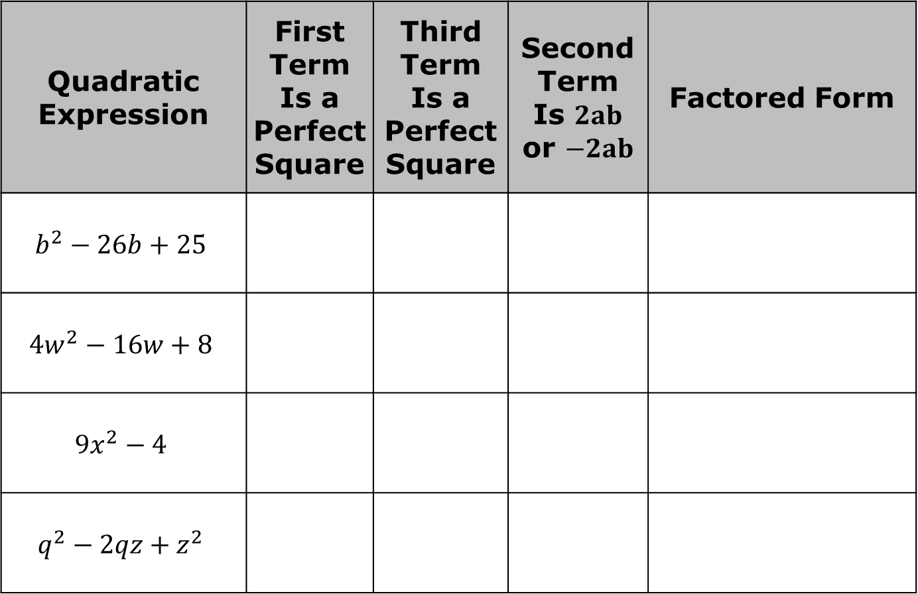
Quadratic Expression | First Term Is a Perfect Square | Third Term Is a Perfect Square | Second Term Is $2ab$ or $−2ab$ | Factored Form
$$b^{2}−26b+25$$
$${4w}^{2}−16w+8$$
$$9x^{2}−4$$
$$q^{2}−2qz+z^{2}$$
volume 1, pg. 396

Slide 21

Your Turn
volume 1, pg. 396

Slide 22
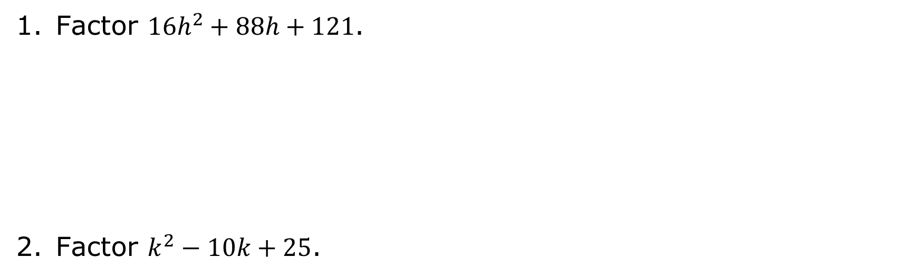
7.7.5 Your Turn!
Factor $16h^{2}+88h+121$.
Factor $k^{2}−10k+25$.
volume 1, pg. 396

Slide 23

Wrap-Up
volume 1, pg. 397

Slide 24
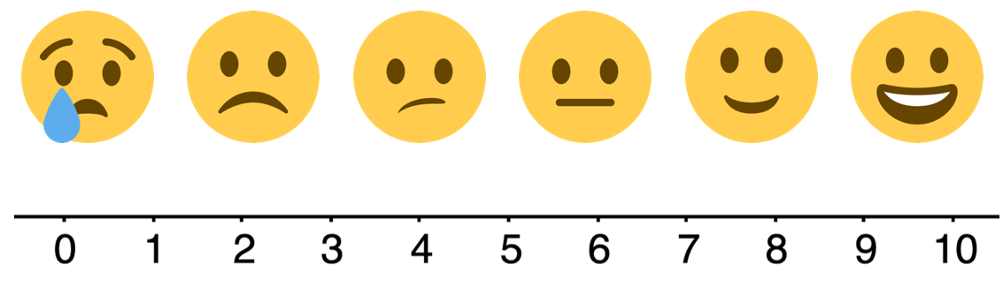
7.7.6 Wrap-Up: Reflection
Choose the emoji that reflects your understanding of factoring perfect square trinomials.
volume 1, pg. 397

Slide 25
Complete the statement.
I chose this emoji because ___ _________ _____ __________ _____________________________ .
volume 1, pg. 397

